Slide 1
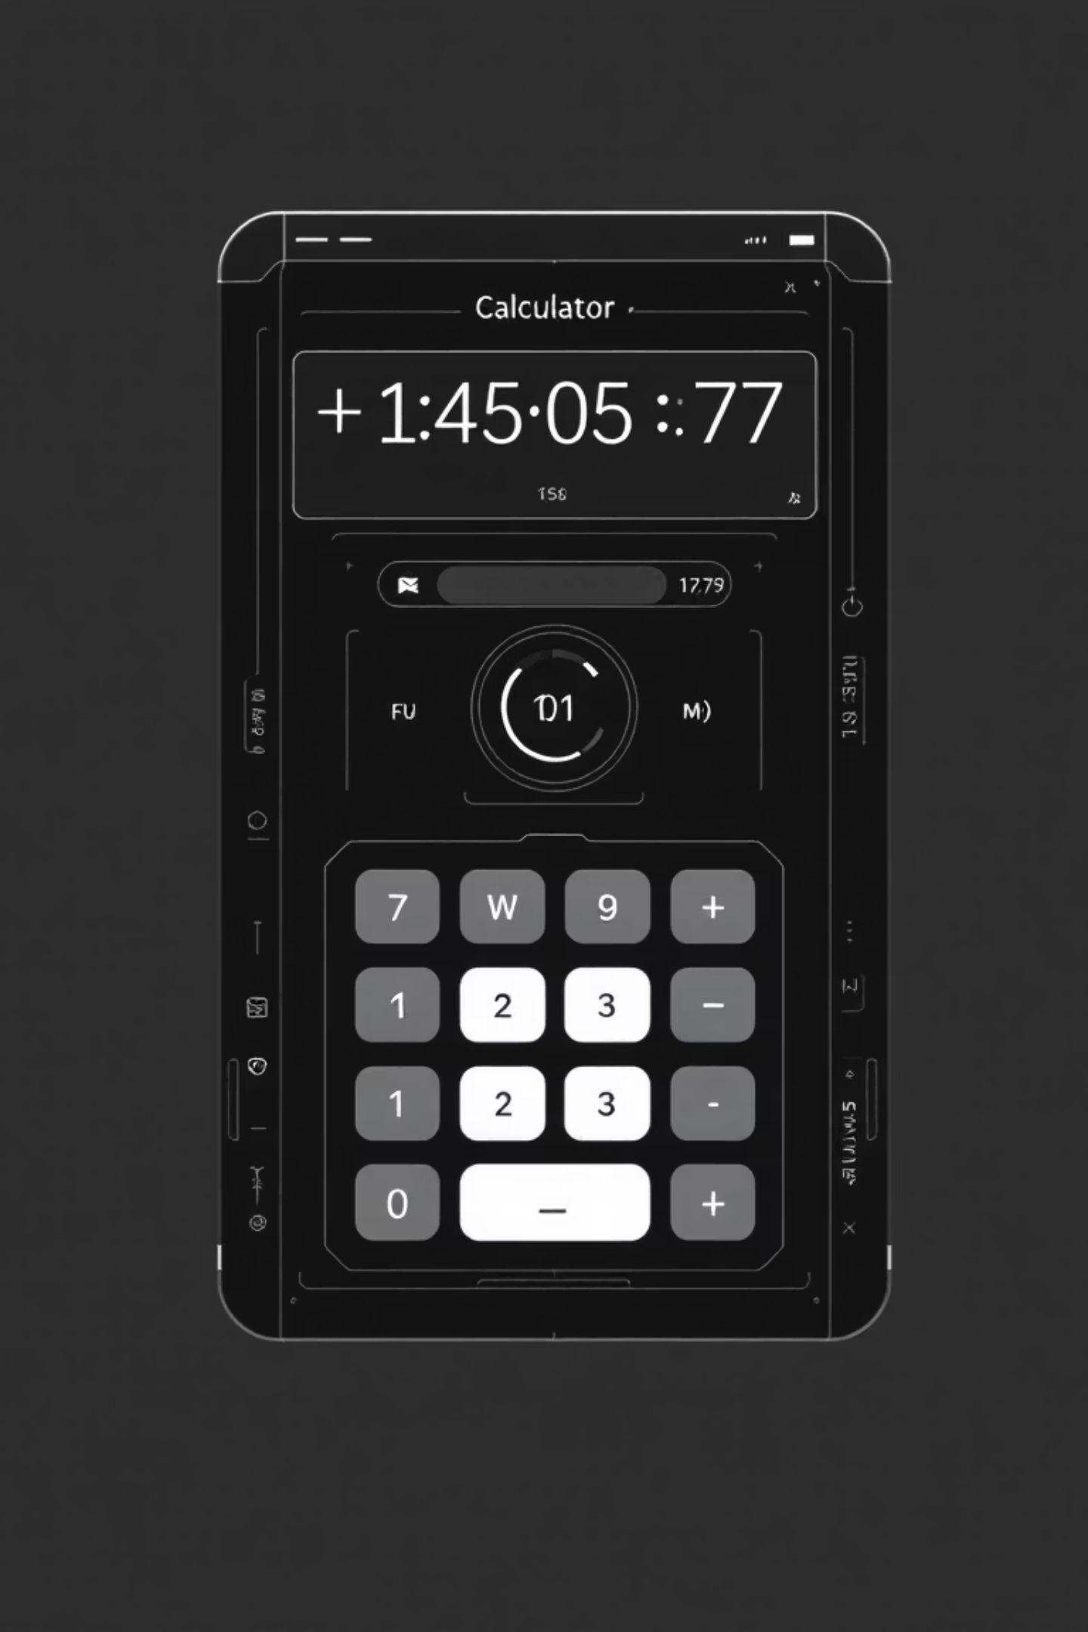
Nexthikes Project by
The Advanced Calculator
A deep dive into the architecture and functionality of a modern calculator.
Presented by : Varun

Slide 2

Building an Advanced Calculator - Buttons, Operations & Clear Function
This presentation outlines the fundamental components and logic required to develop a sophisticated calculator application.

Slide 3
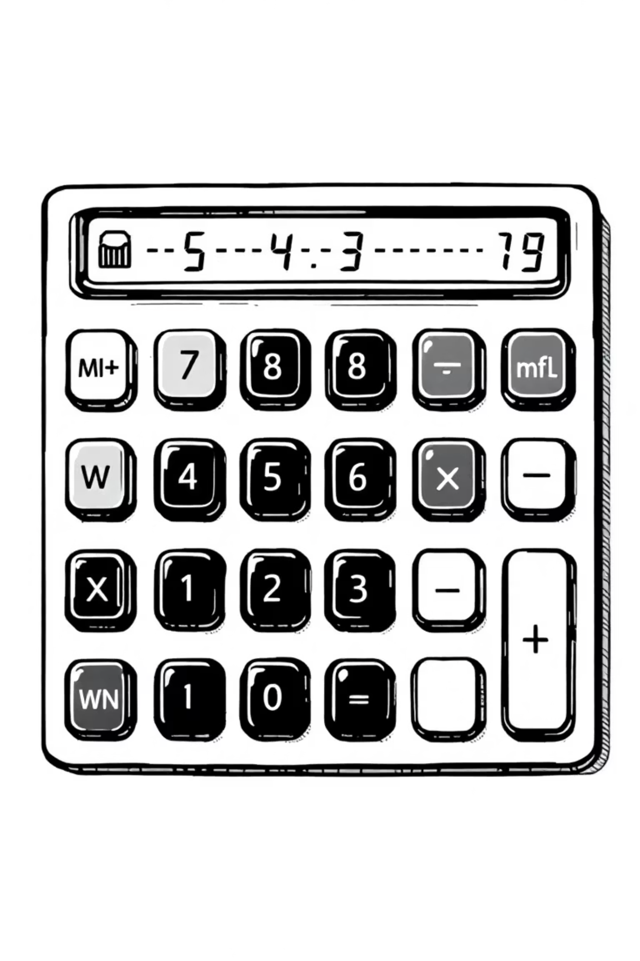



Core Components of a Calculator UI
Numeric Buttons
Digits 0 through 9 for precise input.
Operator Buttons
Basic arithmetic operations: +, -, *, /.
Functional Buttons
Clear (C) for reset and Equals (=) for calculation.

Slide 4

Designing Numeric Buttons (0 to 9)
Each numeric button, from 1 to 0, serves as the primary input for the calculator.
Create buttons labeled 1, 2, 3 ... 9, 0.
Each button press appends its digit to the current display, forming the input number.
Utilize a grid layout for an intuitive and familiar number pad arrangement, similar to a phone keypad.

Slide 5

Implementing Operator Buttons (+, -, *, /)
Operator buttons are crucial for defining the arithmetic action between numbers.
Trigger Operations
Store First Operand
Operators initiate arithmetic processes on the currently displayed value.
When an operator is pressed, the current number is stored as the first operand.
Select Operator
Prepare for Second Operand
The chosen operator (+, -, *, /) is registered for the upcoming calculation.
The calculator clears the display, ready for the user to input the next number.

Slide 6
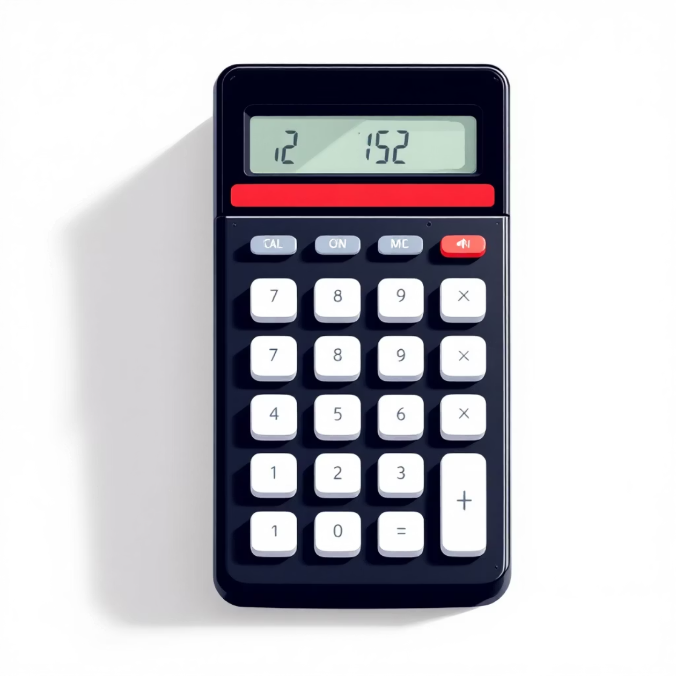
The Clear Button (C)
The "Clear" button is an indispensable feature, ensuring user control and error correction.
Resets the input display to zero, providing a clean slate.
Clears any stored operands or operators, allowing a fresh start without refreshing the application.
Enhances usability by quickly undoing mistakes or beginning a new calculation sequence.

Slide 7
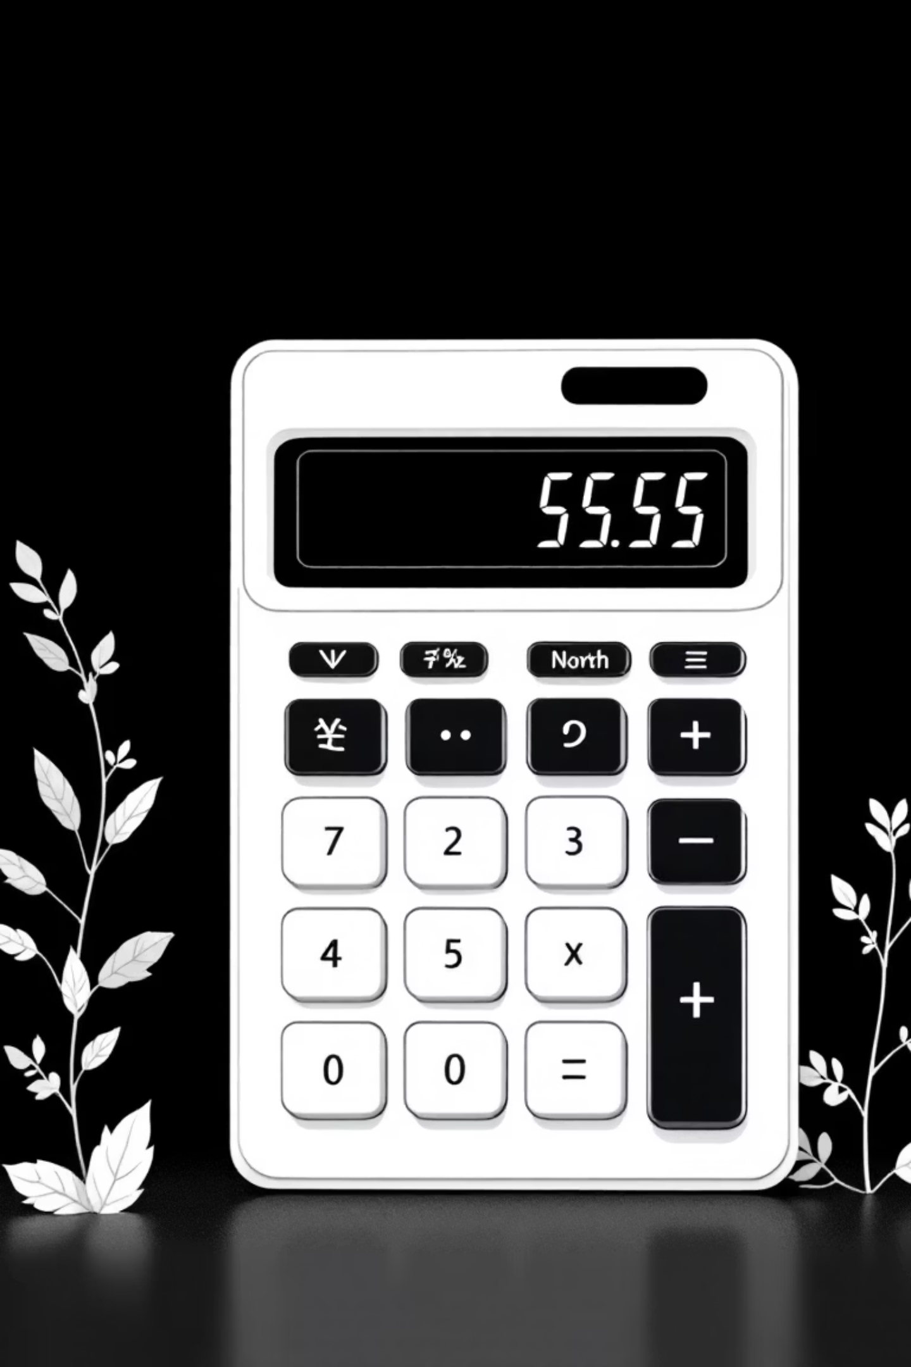
The Equals Button (=)
The "Equals" button is the gateway to results, executing the pending arithmetic operation.
01
02
Execute Operation
Display Result
Triggers the calculation using the stored first operand, the selected operator, and the currently displayed number.
Shows the final computed value prominently on the calculator's screen.
03
Handle Edge Cases
Crucially, it manages special scenarios like division by zero, presenting an error message rather than crashing.

Slide 8

Example: Basic JavaScript Logic for Button Handling
Understanding the underlying logic simplifies calculator development.
Numeric Button
onClick => display += digit
Appends the clicked digit to the display string.
Operator Button
onClick => store(display, operator); clear display
Stores the current number and operator, then clears the display for the next input.
Equals Button
onClick => calculate(storedValue, operator, display)
Performs the stored operation with the final input and displays the outcome.
Clear Button
onClick => reset display and stored values
Wipes all current inputs and stored states, returning to an initial state.

Slide 9

Summary & Next Steps
Foundational Logic: Combining buttons and their associated logic creates a functional and reliable calculator.
Enhanced User Experience: The Clear and Equals buttons are essential for intuitive user control and smooth operation.
Future Enhancements: Consider adding features like decimal points, parentheses for complex equations, and memory functions for more advanced calculations.
Call to Action: Ready to build your own? Start coding your button components and bring your calculator to life today!
Thanking you

